Slide 1

Downstream high-speed plasma jet generation as a direct consequence of shock reformation Savvas Raptis Division of Space and Plasma Physics KTH Royal Institute of Technology, Stockholm, Sweden IRF Uppsala Seminars 16/03/2022

Slide 2
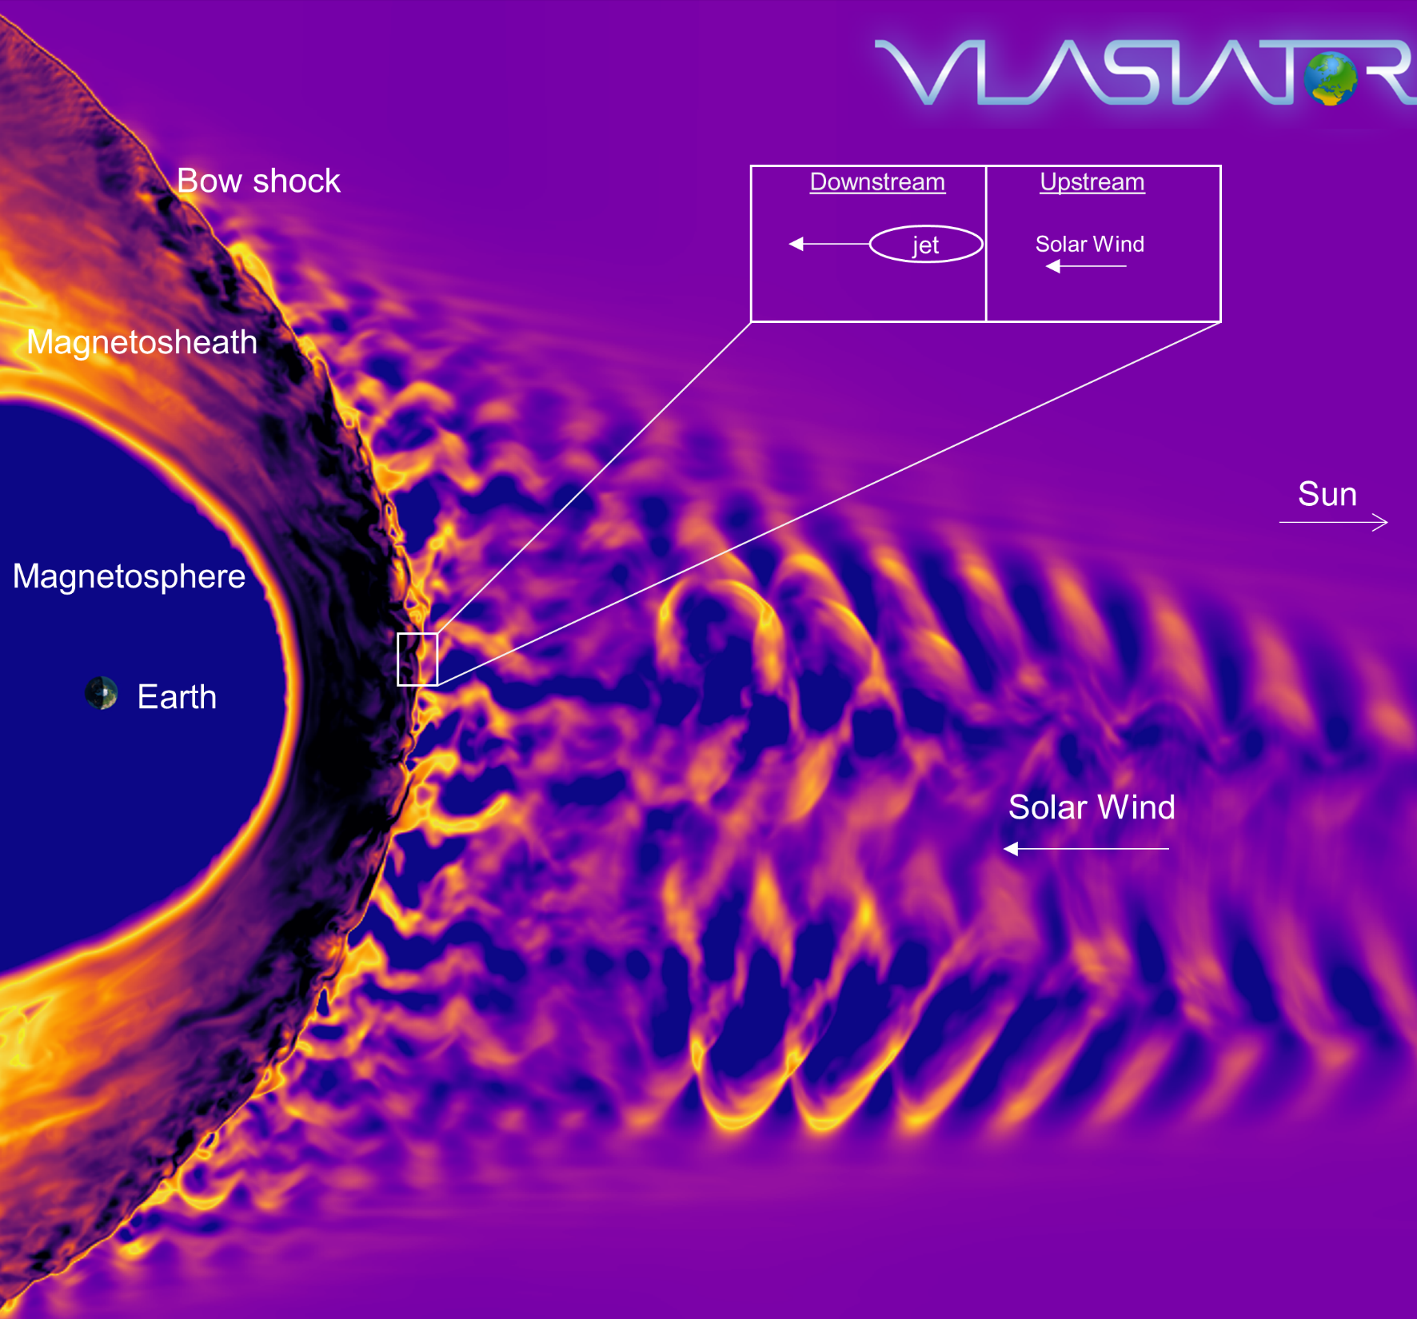
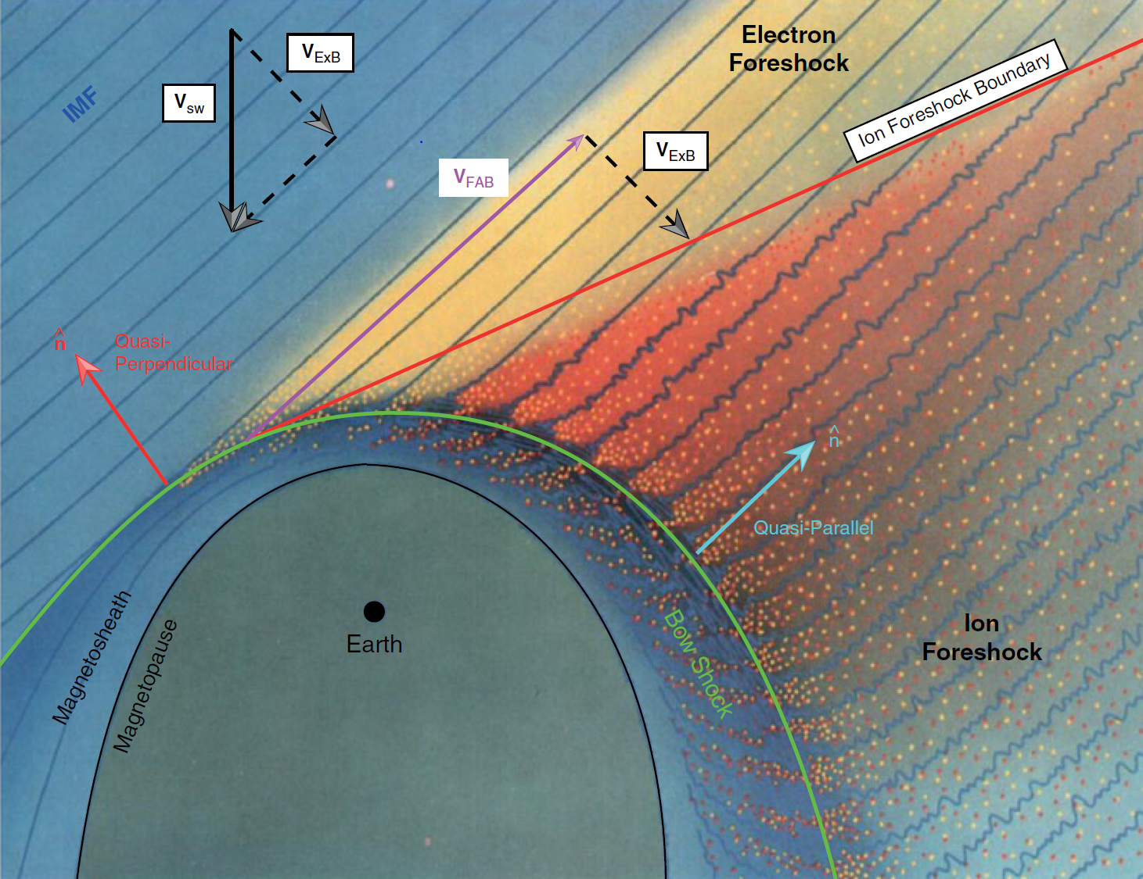
Earth’s Magnetosphere & Shock environment
Lynn Wilson – Solar Wind
Heli Hietala – The Bowshock and Foreshock
Ferdinand Plaschke – The Magnetosheath
https://msolss.github.io/MagSeminars/
Courtesy of M. Palmroth, U Helsinki
L. B. Wilson (2016)

Slide 3
Introduction
Jets | Reformation | MMS

Slide 4
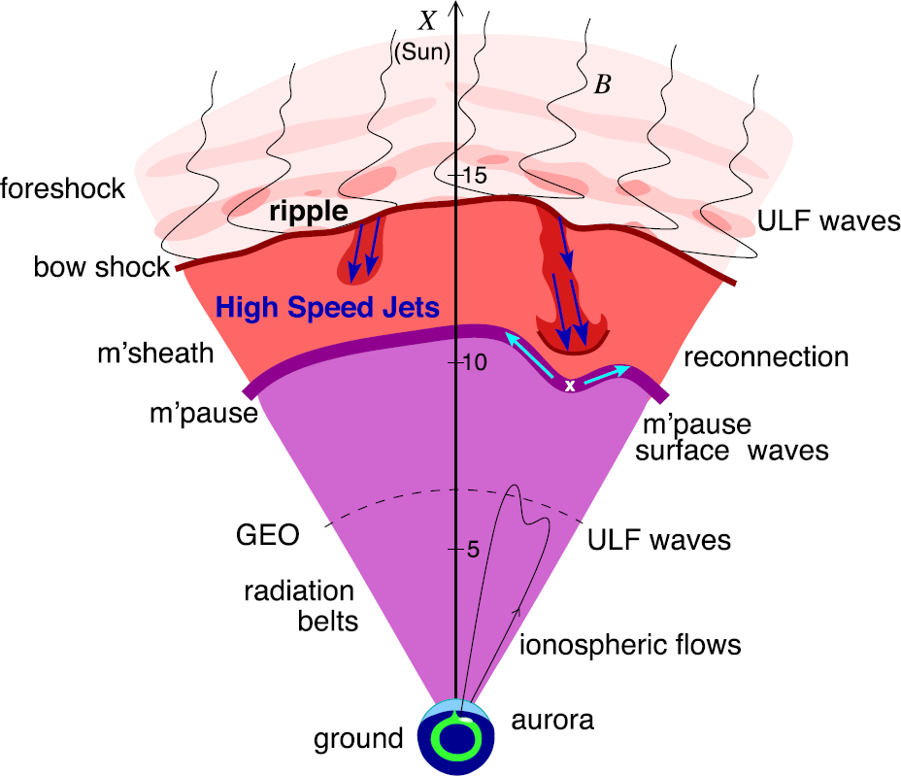
Magnetosheath Jets – Definition
Definition
Magnetosheath jets are transient localized enhancements of dynamic pressure (density and/or velocity increase)
e.g., 200% dynamic pressure enhancement compared to background magnetosheath
Related phenomena
Radiation belts
Throat aurora
Magnetopause reconnection
Magnetopause penetration
Shock acceleration
Magnetopause surface eigenmodes
ULF waves
Plaschke F. et al. (2018); sketch by H. Hietala | Space Sci. Rev

Slide 5
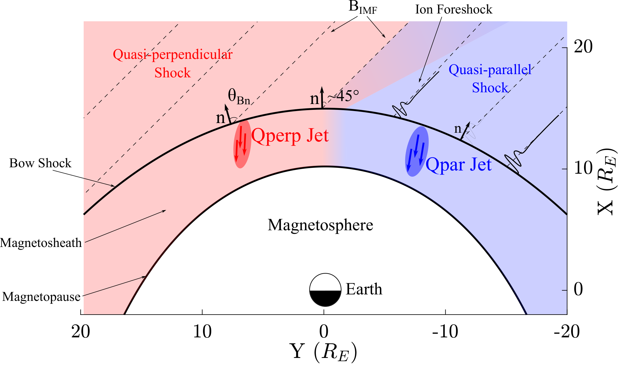
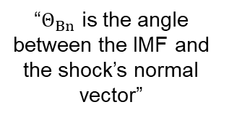
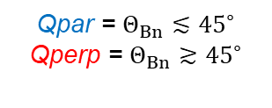
Shock, Magnetosheath & Jet classification
“$Θ_{Βn}$ is the angle between the IMF and the shock’s normal vector”
Qpar = $Θ_{Βn}≲{45}^{∘}$
Qperp = $Θ_{Βn}≳{45}^{∘}$
”Jets found ~9 times more often in the Qpar MSH”
Vuorinen et al. (2019)
Raptis, Karlsson, et al. (2020) | JGR
Raptis, Aminalragia-Giamini et al. (2020) | Front. Astron. Space Sci
Karlsson, Raptis et al. (2021) | JGR
Kajdič, Raptis et al. (2021) | GRL

Slide 6
Jet – Typical Examples with MMS
Dynamic Pressure
(Pa)
velocity
enhancement
Dynamic Pressure
Ratio
Velocity
(km/s)
density
enhancement
Density
(cm⁻³)
Magnetic Field
(nT)
Differential Ion Energy
Spectrum (eV)
Ion Temperature
(eV)
Raptis, Karlsson, et al. (2020) | JGR

Slide 7
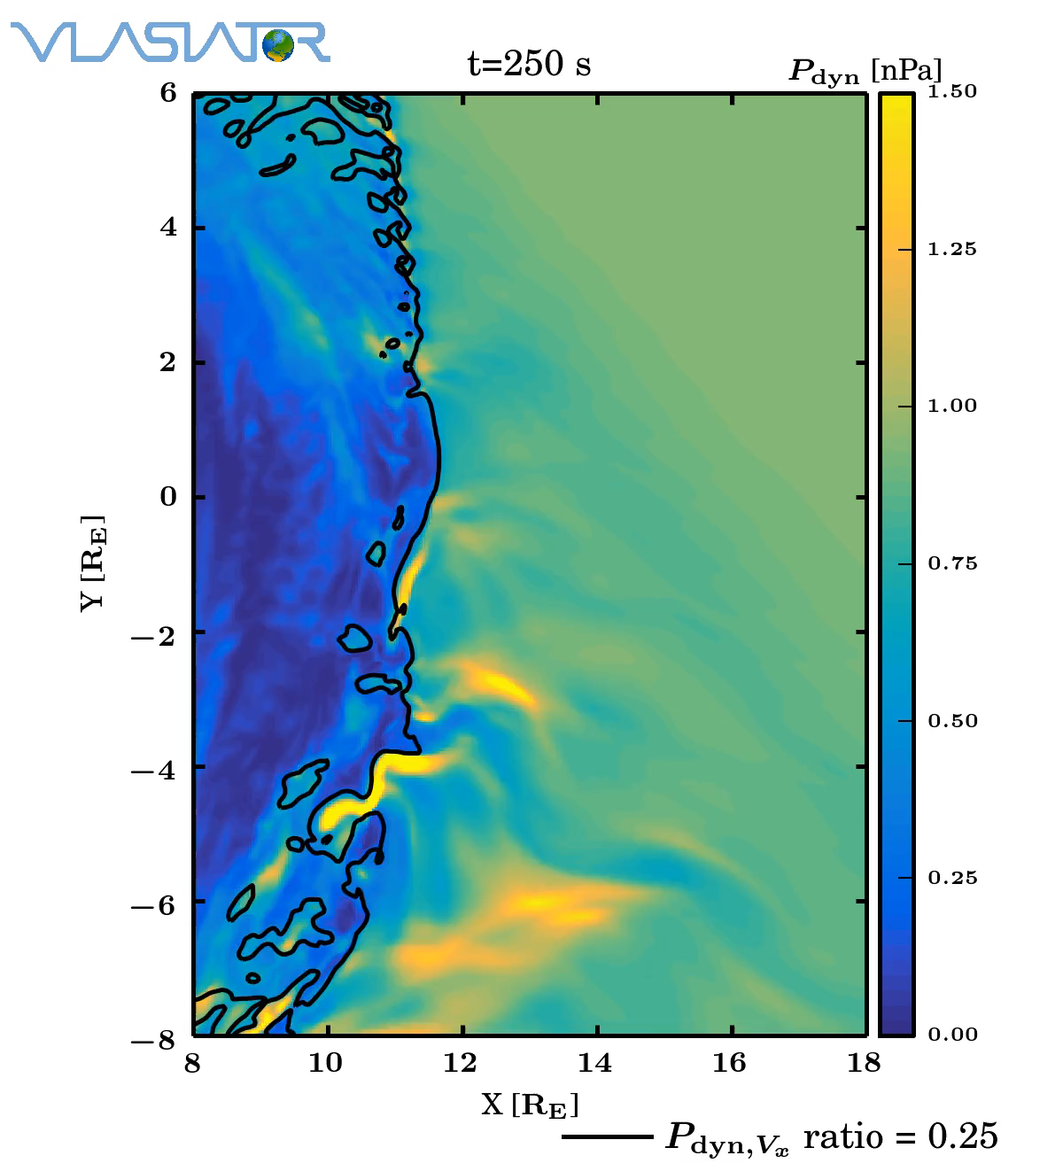
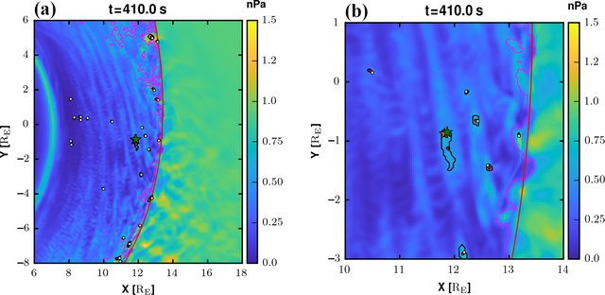
Jets in simulations
Palmroth M., et al. (2018, 2021)

Slide 8
Jets – references update (>2019)
Associated phenomena & effects
Excitation of surface eigenmodes at magnetopause: Archer et al. (2019, 2021)
Mirror mode waves and jets : Bianco-Cano et al. (2020)
Bursty magnetic reconnection at the Earth's magnetopause : Ng et al. (2021)
Ground-based magnetometer response : Norenius et al. (2021)
Generation of Pi2 pulsations : Katsavrias et al. (2021)
B in jets, Bz variations near magnetopause : Vuorinen et al. (2021)
Modeling & formation
Velocity & magnetic field alignment in jets : Plaschke et al. (2020)
Classification of jets using MMS & Neural Networks : Raptis et al. (2020a,2020b)
Comparison MMS vs simulations : Palmroth et al. (2021)
Solar wind effect on jet formation : LaMoury et al. (2021)
Magnetosheath Jets and Plasmoids - Hybrid Simulations : Preisser et al. (2020)
Formation of jets in Quasi-perpendicular magnetosheath : Primoz et al. (2021)
Jets Downstream of Collisionless Shocks
Plaschke et al. (2018)
https://link.springer.com/article/10.1007/s11214-018-0516-3
And more : Liu et al. (2020a,2020b), Omelchenko et al (2021), Sibeck et al. (2021), Suni et al. (2021), Tinoco-Arenas et al. (2022) … etc. etc.

Slide 9
But how are jets formed?

Slide 10
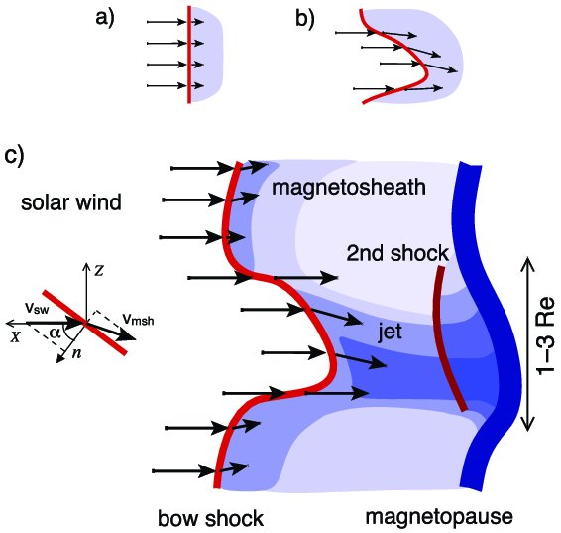
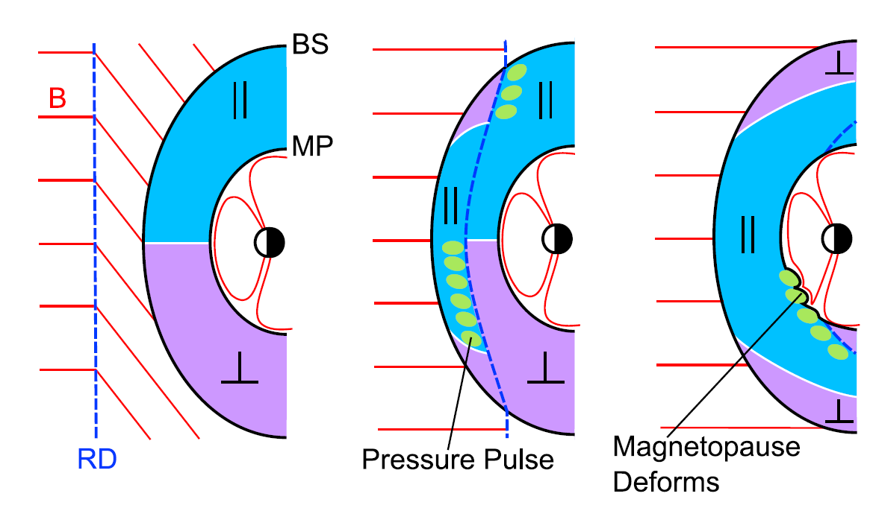
How are these jets created ?
Shock ripples
SW discontinuities
Foreshock Structures
SW → locally inclined part of the bow shock → less deceleration and heating
Hietala et al. (2009,2012)
Archer et al. (2012)
Karlsson et al.(2015), Suni et al. (2021), Raptis et al. (2022)

Slide 11
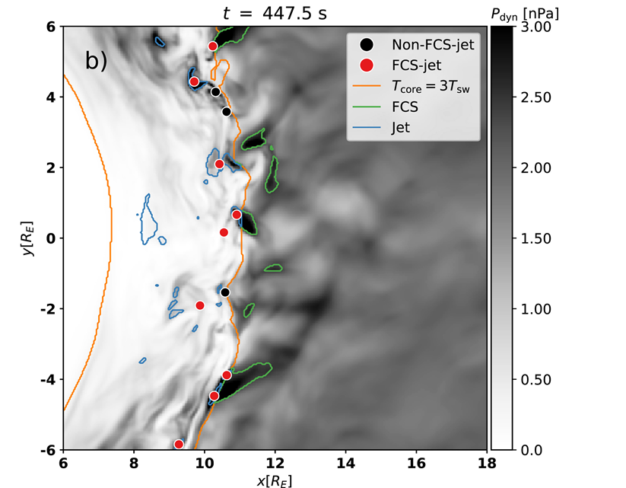
Why foreshock & jets ?
Observations
Simulations
Karlsson et al. (2012, 2015):
Palmroth et al. (2018): “high-dynamic-pressure structure that reproduces observational features associated with a short, large-amplitude magnetic structure (SLAMS)”
Embedded plasmoid = density
Fast plasmoid = density + velocity
“…plasmoids, … properties in common with SLAMS…”
Suni et al. (2021): “We find that 75% of jets are caused by Forceshock Compressive Structures”
Raptis et al. (2020): “… SLAMS-associated mechanisms are therefore supported and appear to be key elements of jet formation... “
HFA : Savin et al. (2012)
SHFA : Zhang et al. (2013)
Foreshock Cavities : Sibeck et al. (2021)
HFA: Omidi et al. (2013)

Slide 12
Introduction
Jets | Reformation | MMS

Slide 13
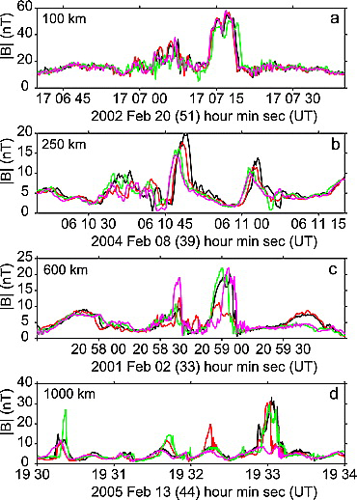
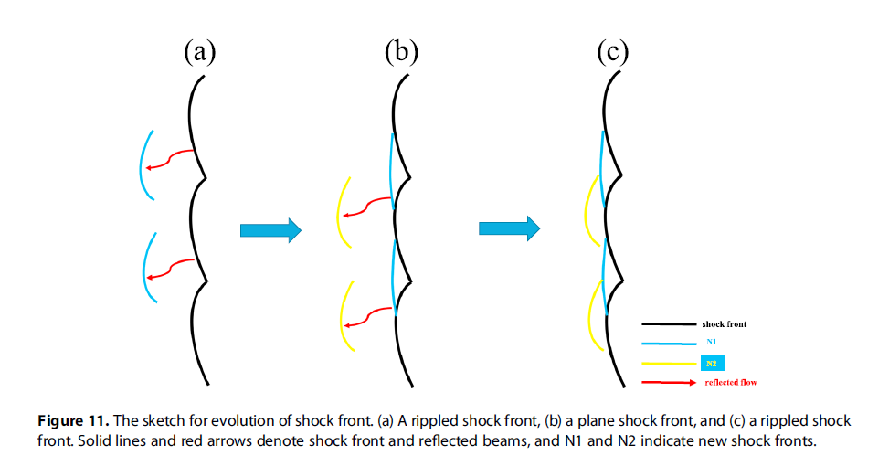
Shock Reformation & SLAMS – Clarification
Shock Reformation
Burgess (1989): “the shock exhibits a cyclic behavior ….. cyclic shock reformation;”
ULF non-linear evolution = SLAMS
Chen et al. (2020): “…ULF waves can arise at the foreshock and evolve into SLAMS …”
Hao et al. (2017)
Schwartz, (1991)
Similar definitions : Hao et al. (2016,2017), Liu et al. (2021), Johlander et al. (2022), Raptis et al. (2022)
Lucek, (2008)

Slide 14
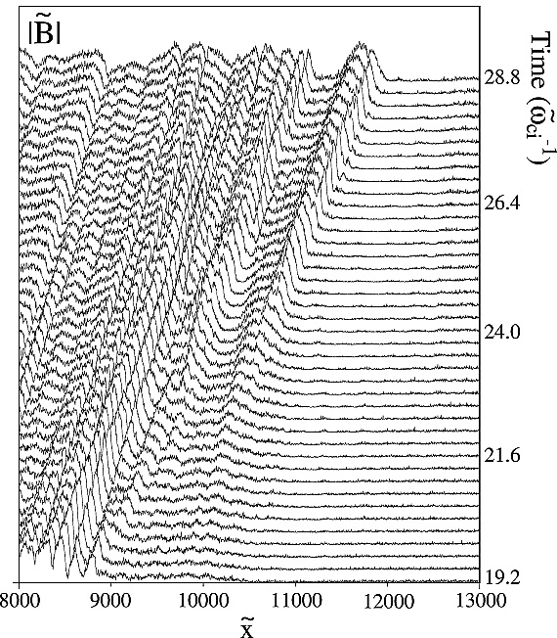
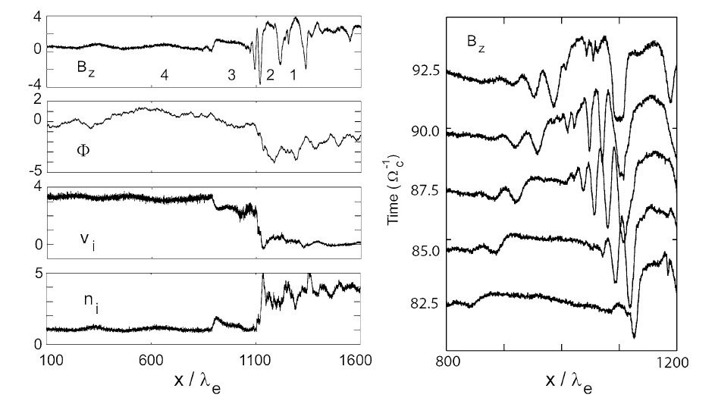
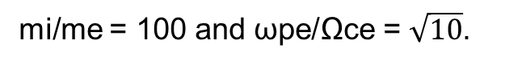
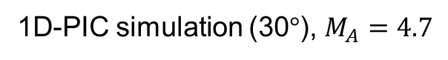
Shock Reformation – Simulations
1D-PIC simulation (30$°$), $M_{A}=4.7$
mi/me = 50 and ωpe/Ωce = 4.
mi/me = 100 and ωpe/Ωce = $\sqrt{10}$.
Scholer et al. (2003) | JGR
Tsubouchi & Lembège (2004) | JGR
More nice sources for review : Burgess & Scholer (2015), Willson (2016)
Notes:
Scholer : MA = 4.7 shock with a mass ratio of mi/me = 100 and ωpe/Ωce = √10 are shown in Fig. The total system size for this simulation is 200c/ωpi.

Slide 15
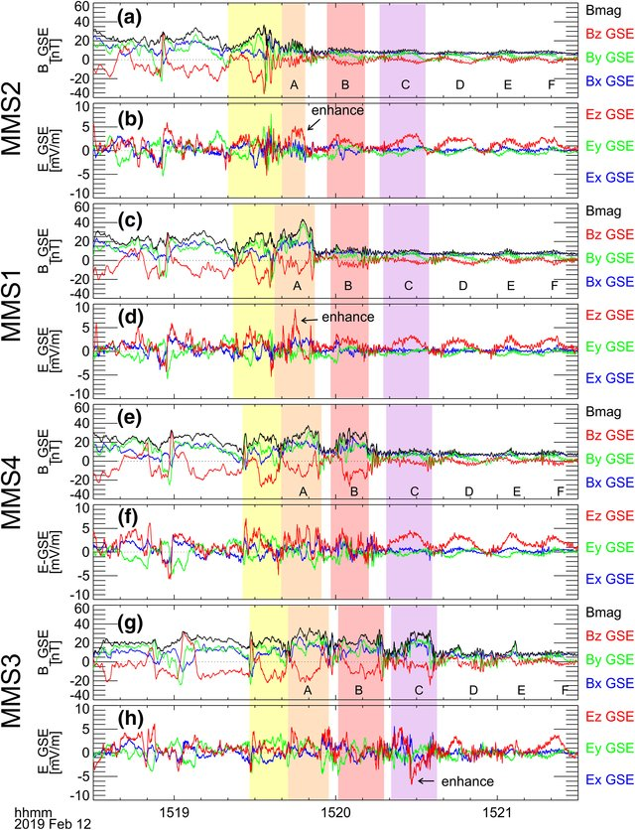
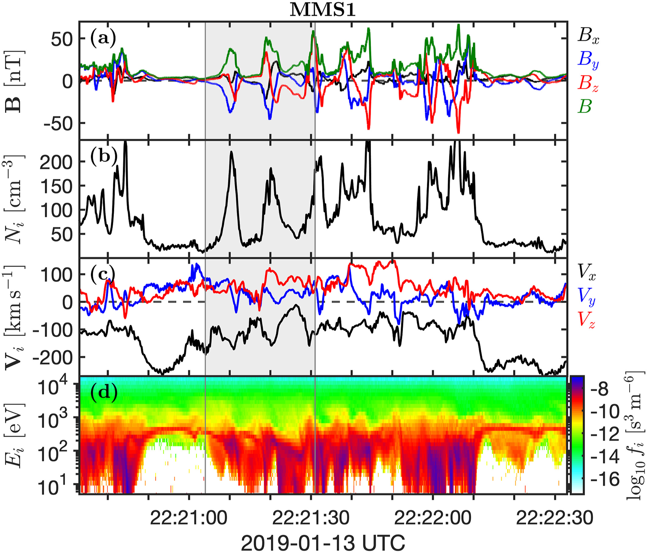
Shock Reformation – Latest Results
Liu et al. (2021)
Johlander et al. (2022)

Slide 16
Introduction
Jets | Reformation | MMS

Slide 17
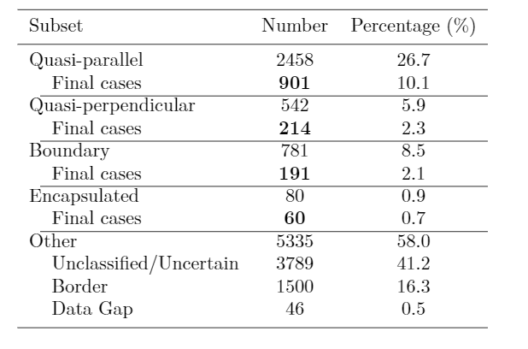
MMS – Jet Database
Fast/Survey
Burst
9/2015 - 9/2020
Jets with full burst data
Qpar | 423
Qperp | 34
Boundary | 35
Encapsulated | 31
Close to BS / MP | 495
Others | 428
Raptis S., Karlsson T., et al. (2020) | JGR
Raptis S., Aminalragia-Giamini S., et al. (2020) | Frontiers
Palmroth M., Raptis S., et al. (2021) | Annales
Kajdic P., Raptis S., et al. (2021) | GRL
Raptis S., Karlsson T., et al. (2022) | Nat. Commun
Raptis S., Karlsson T,, et al. (2022) | Ongoing

Slide 18
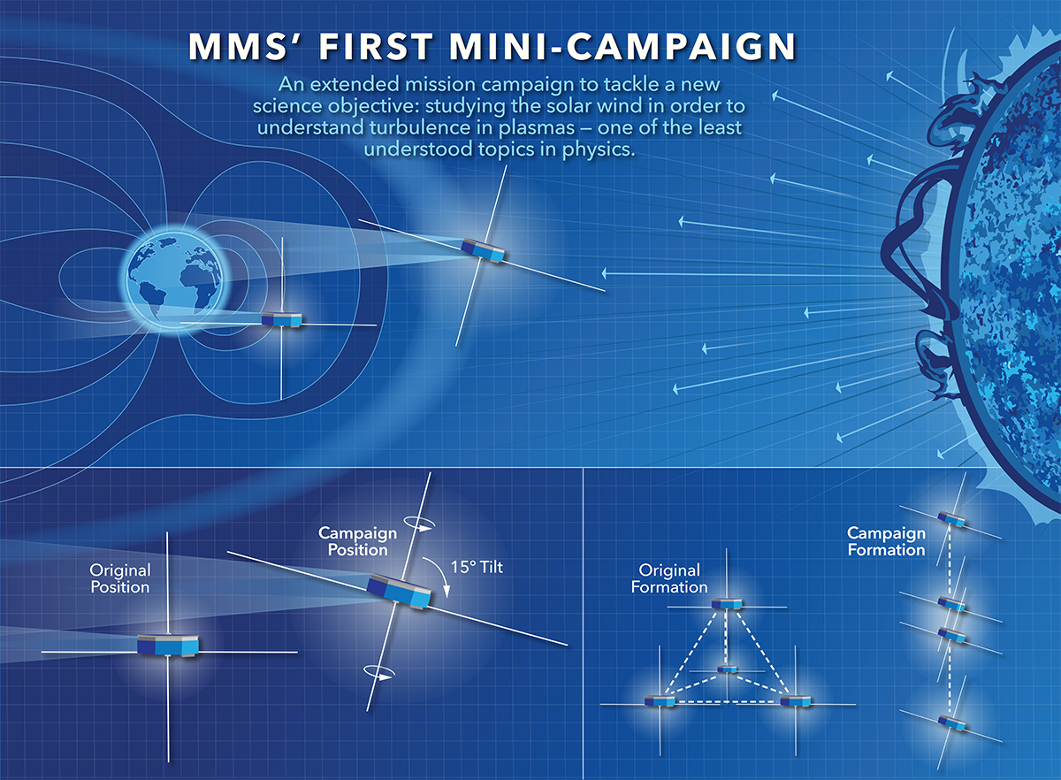


MMS spacecraft + String of Pearl Configuration
Bow Shock
Magnetopause
Earth
Credits: NASA's Goddard Space Flight Center/Mary Pat Hrybyk-Keith

Slide 19
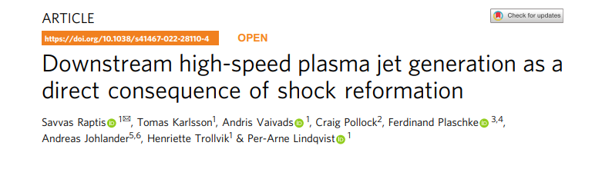
Link : https://www.nature.com/articles/s41467-022-28110-4
GitHub : https://github.com/SavvasRaptis/Jets-Reformation

Slide 20
Results
MMS | Schematic

Slide 21
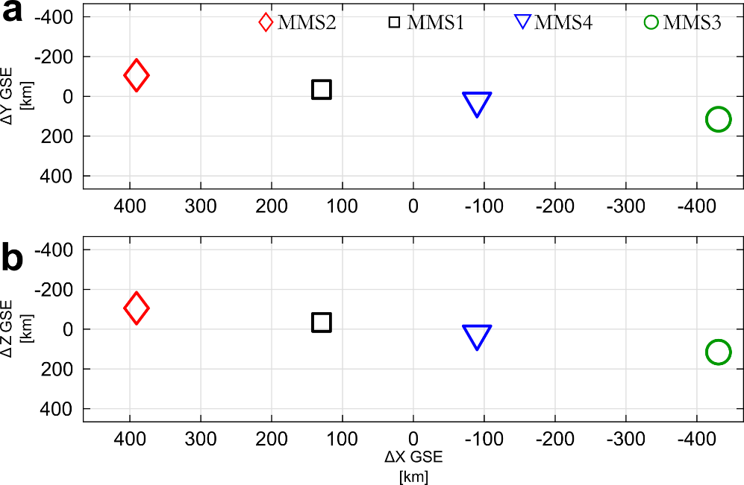
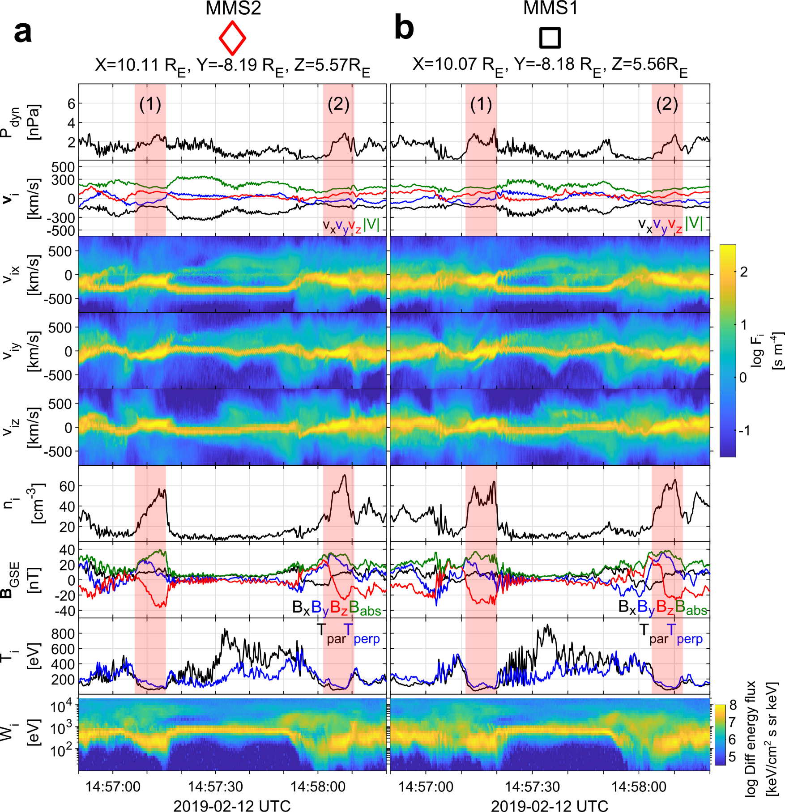
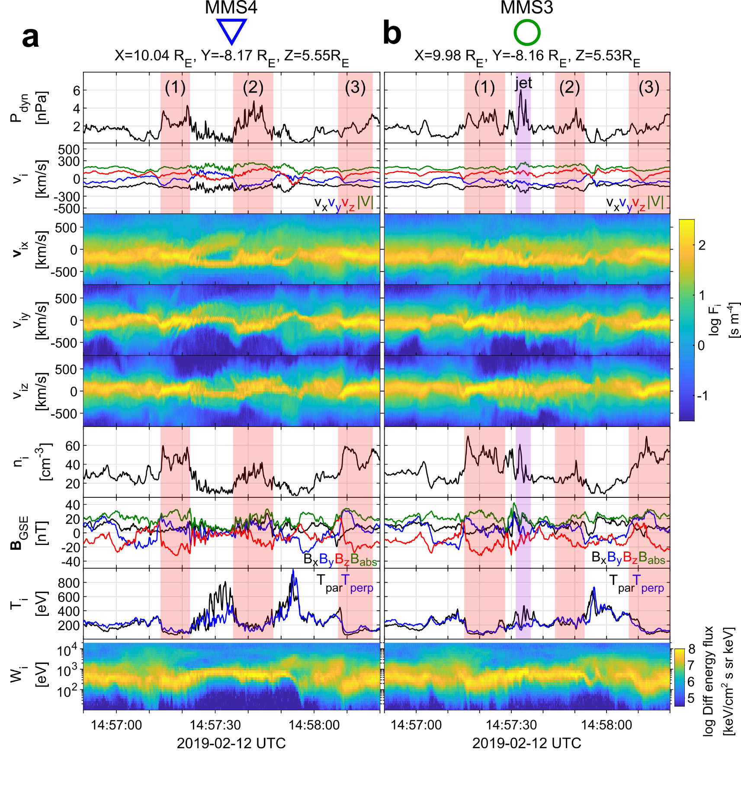
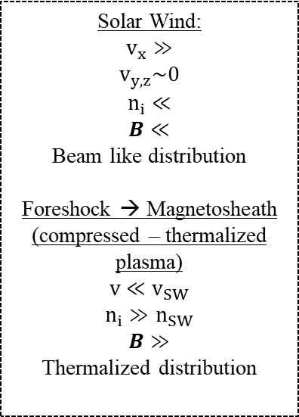
General Observations of MMS
u
d
Solar Wind:
$$v_{x}≫$$
$$v_{y,z}\sim 0$$
$$n_{i}≪$$
$$B≪$$
Beam like distribution
Foreshock → Magnetosheath
(compressed – thermalized plasma)
$$v≪v_{SW}$$
$$n_{i}≫n_{SW}$$
$$B≫$$
Thermalized distribution

Slide 22
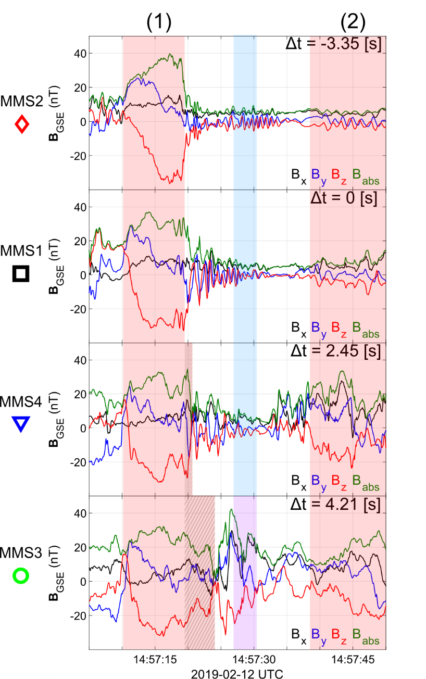

SLAMS & wave activity co-moving picture
Evolution of SLAMS
Interaction with upstream whistler
New peak /evolution*
Formation of embedded plasmoid (downstream density enhancement)**
* See similar examples by Turner et al. (2021), Chen et al. (2021)
** See similar example by Liu et al. (2021)

Slide 23
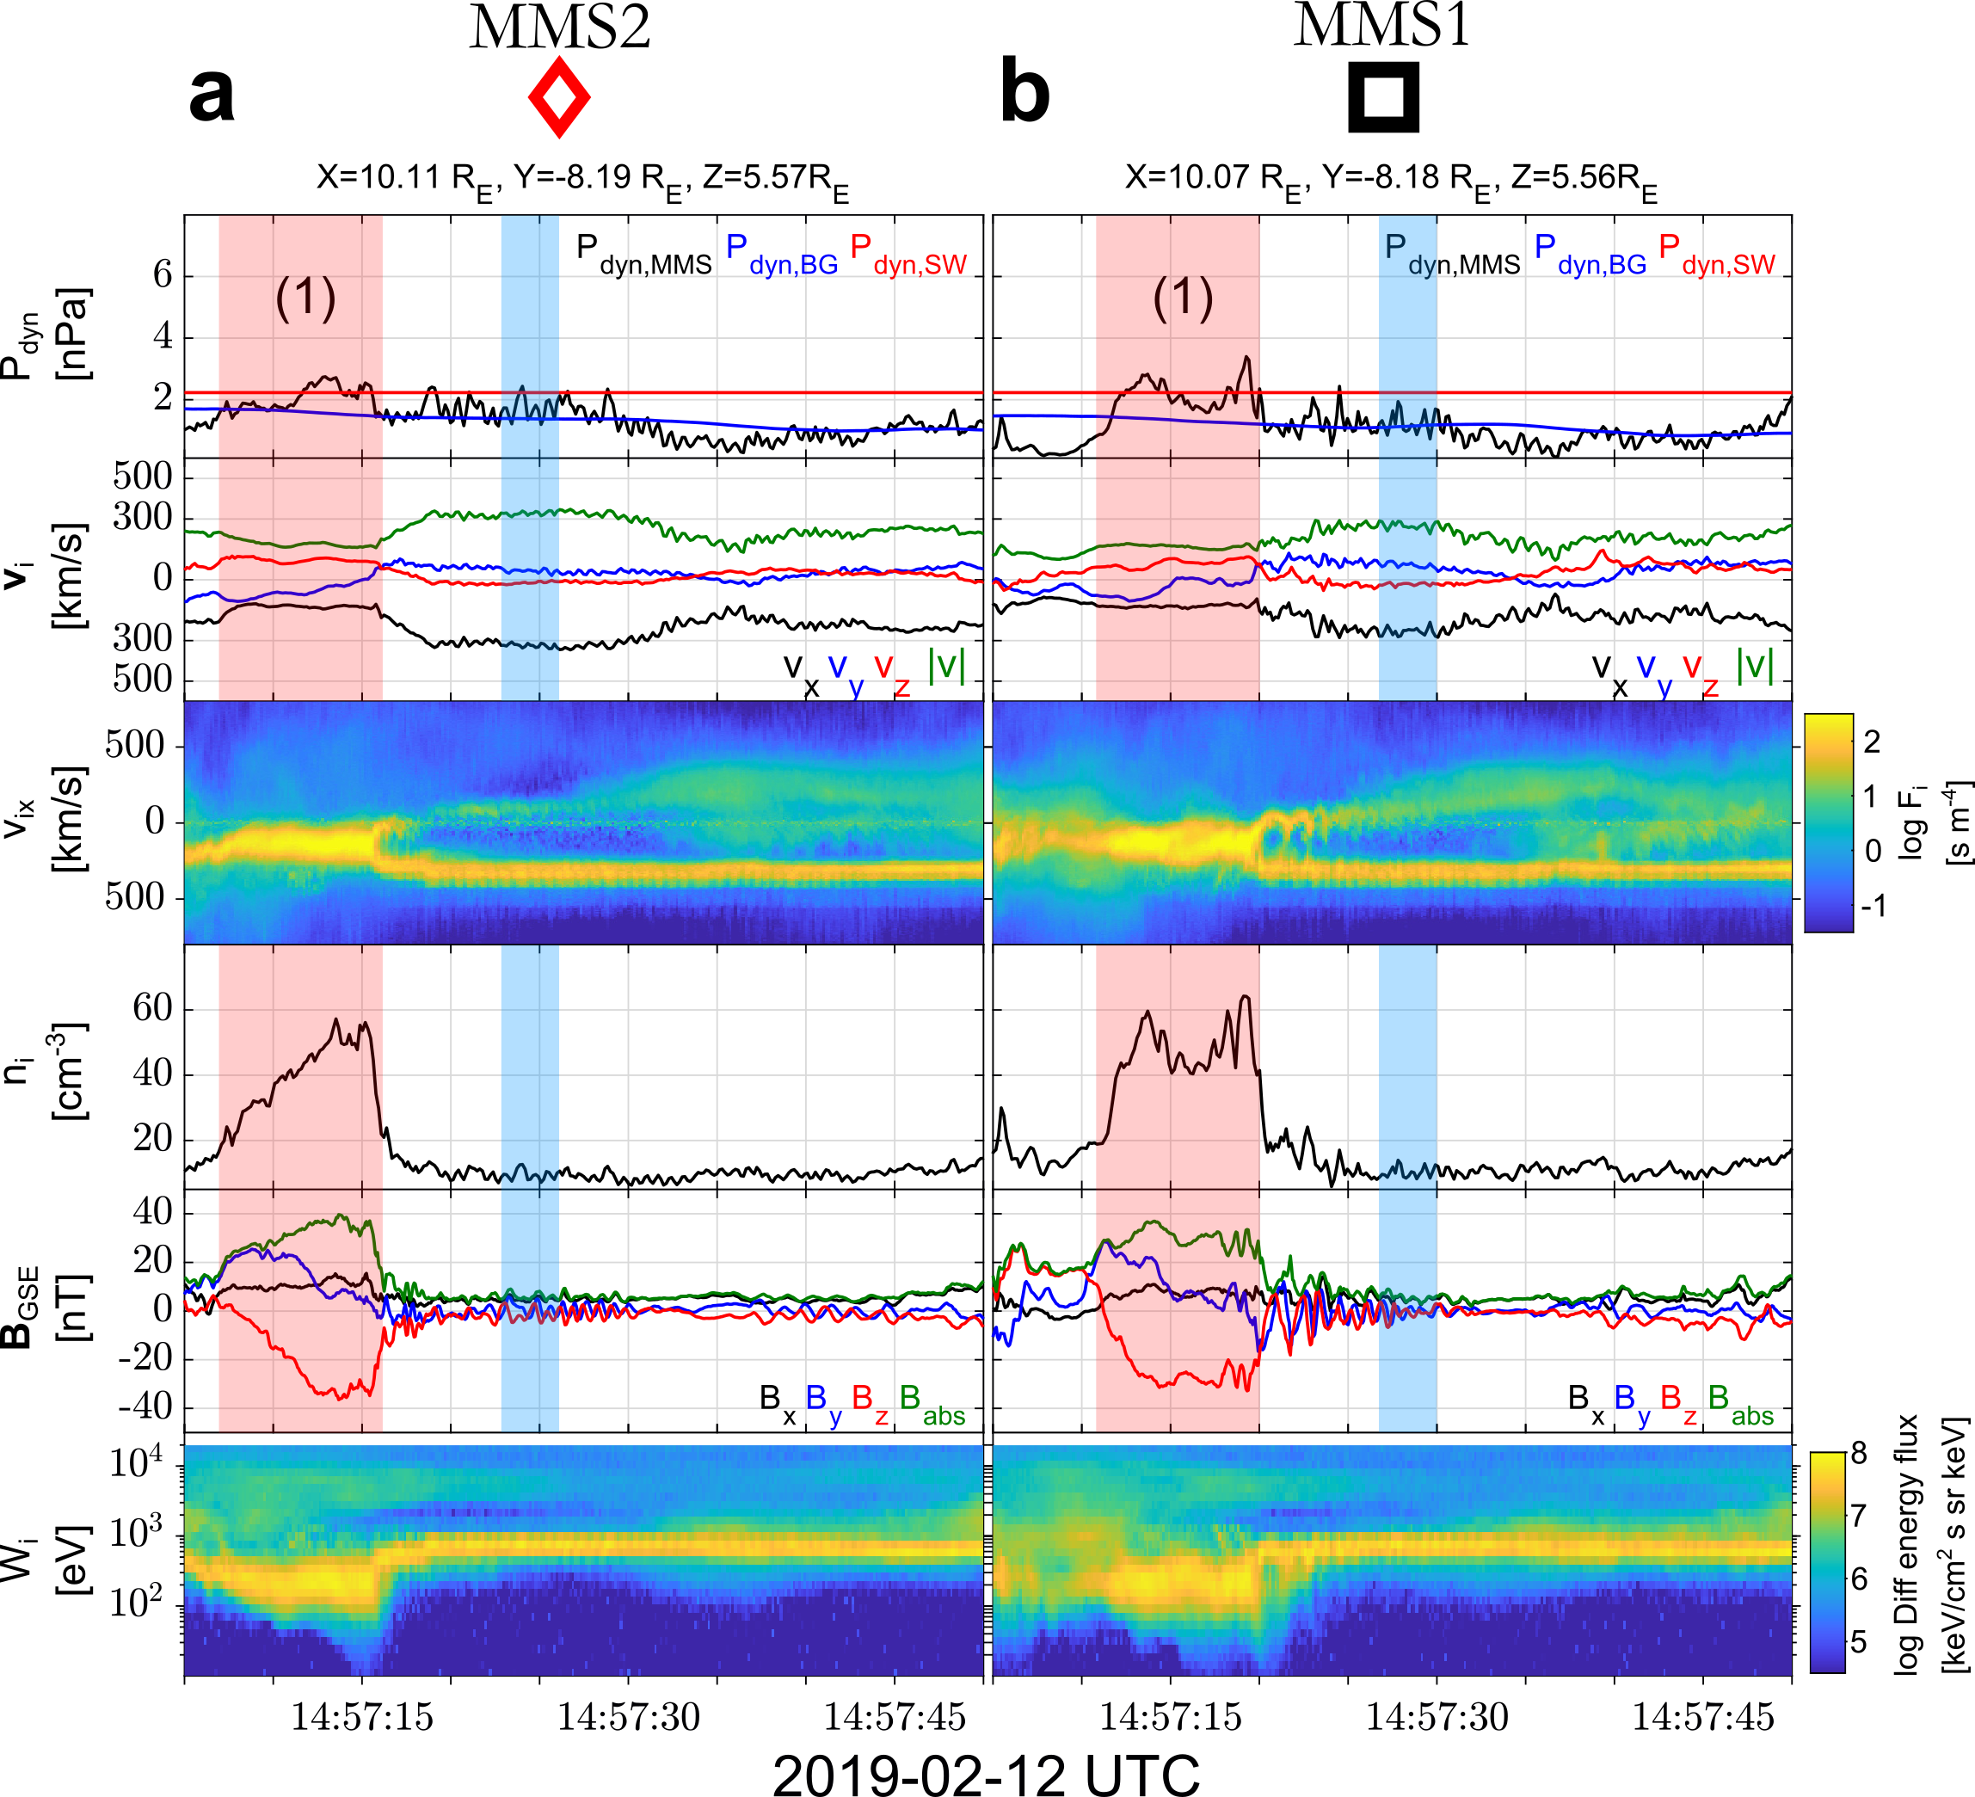
MMS outer-spacecraft observations

Slide 24
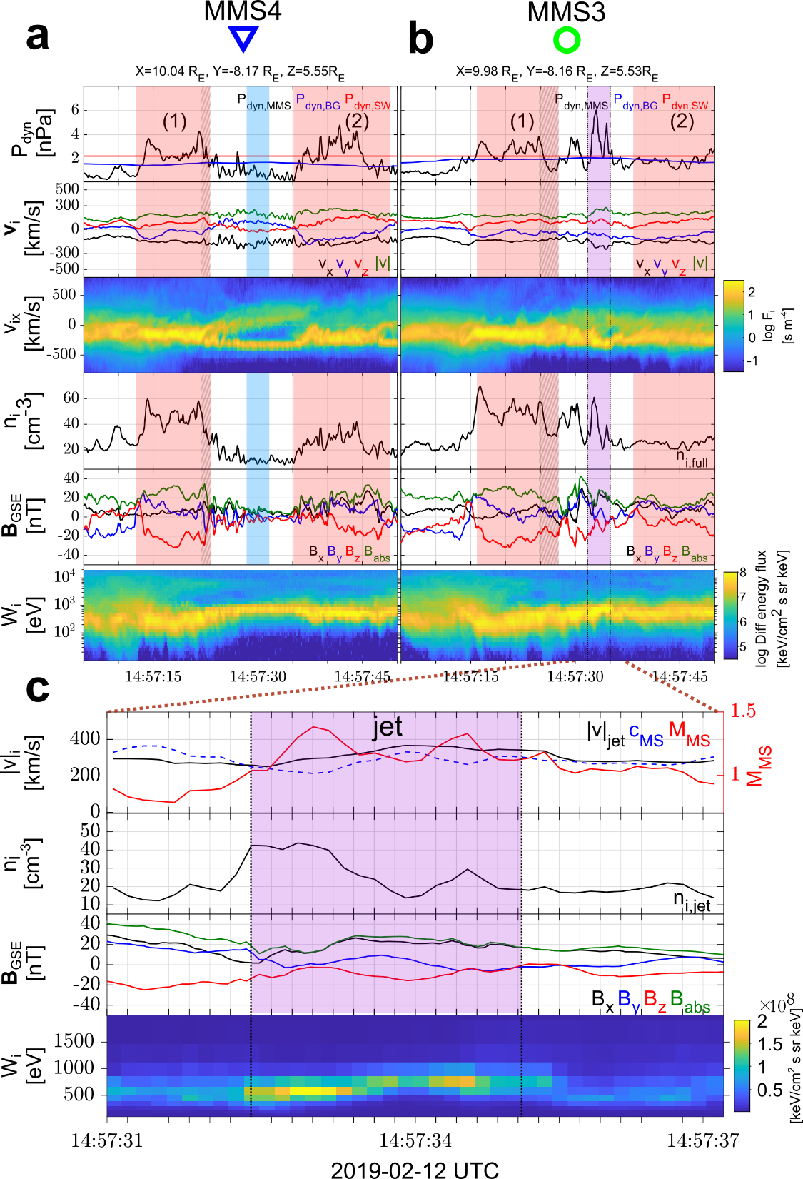
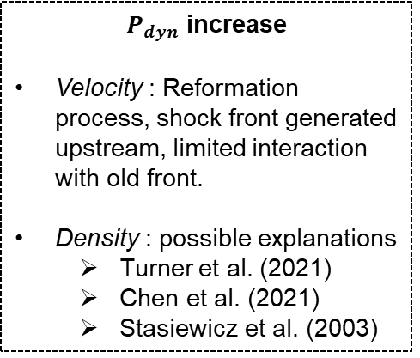
MMS inner-spacecraft observations
$P_{dyn}$ increase
Velocity : Reformation process, shock front generated upstream, limited interaction with old front.
Density : possible explanations
Turner et al. (2021)
Chen et al. (2021)
Stasiewicz et al. (2003)

Slide 25
Results
MMS | Schematic

Slide 26
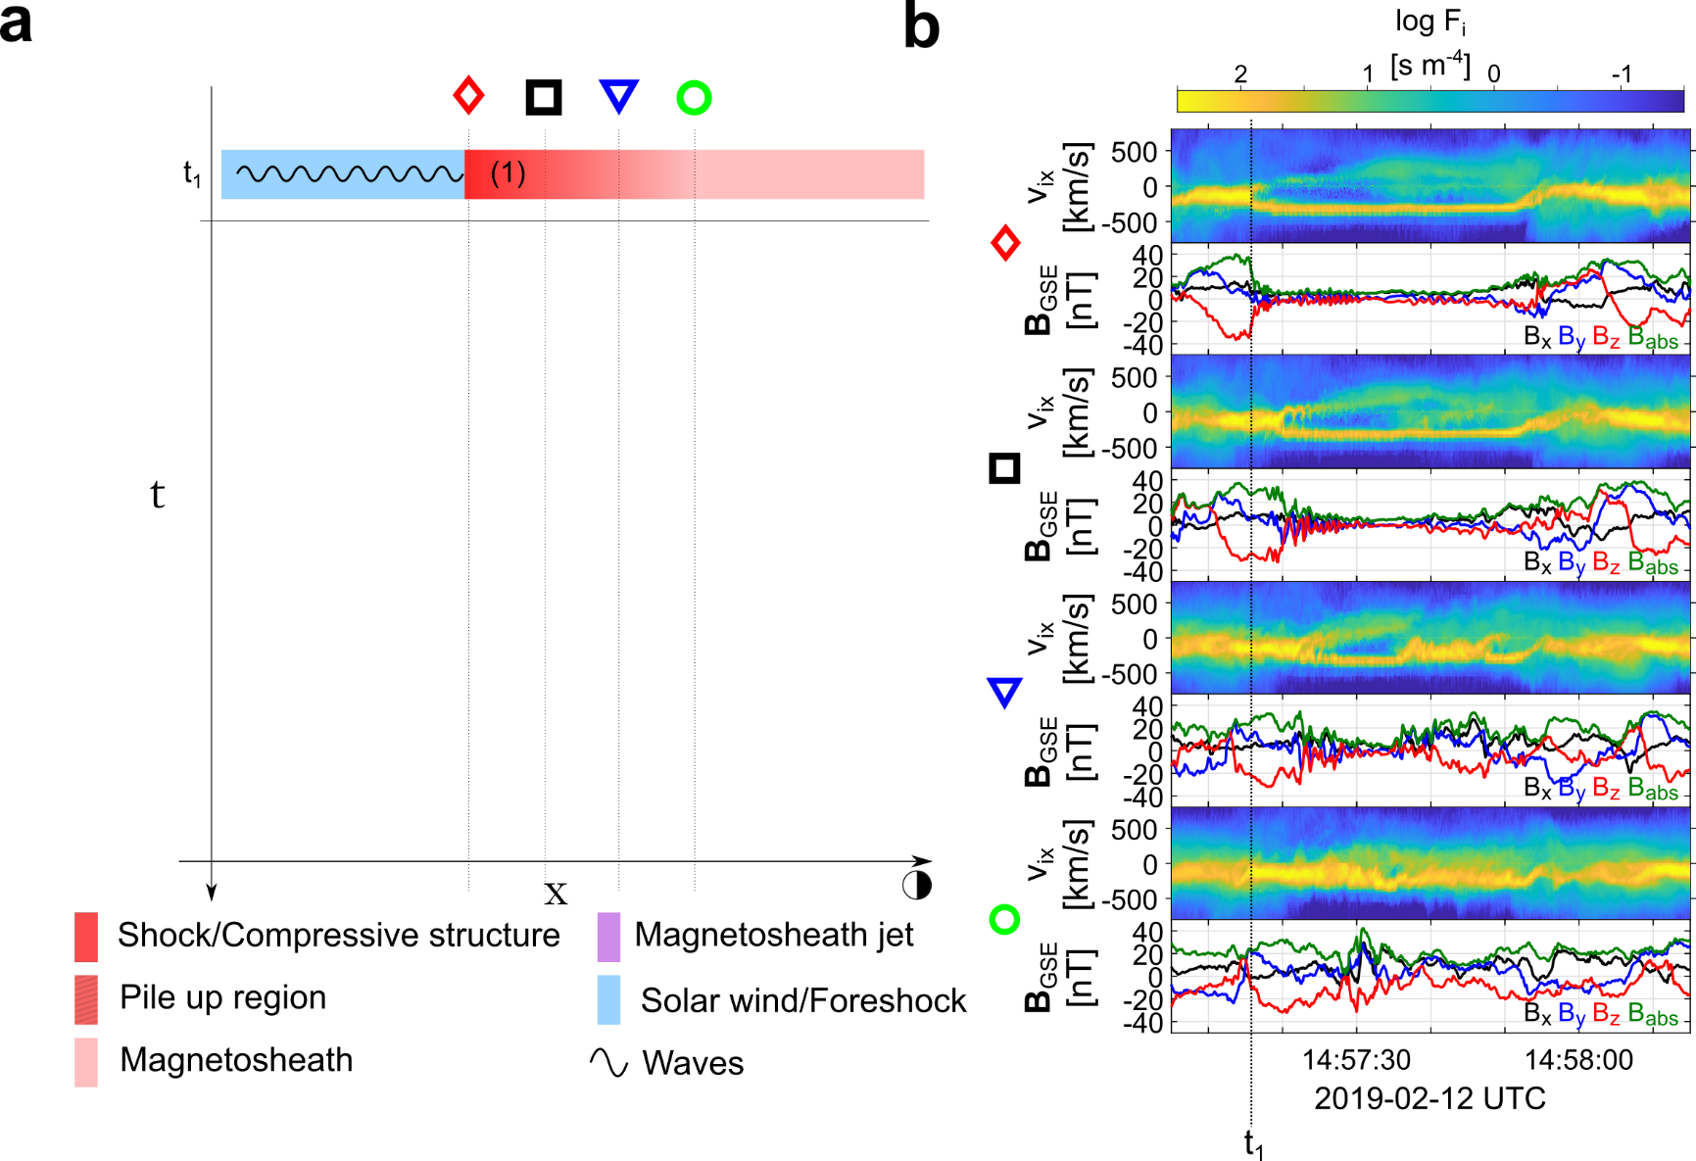
Formation mechanism

Slide 27
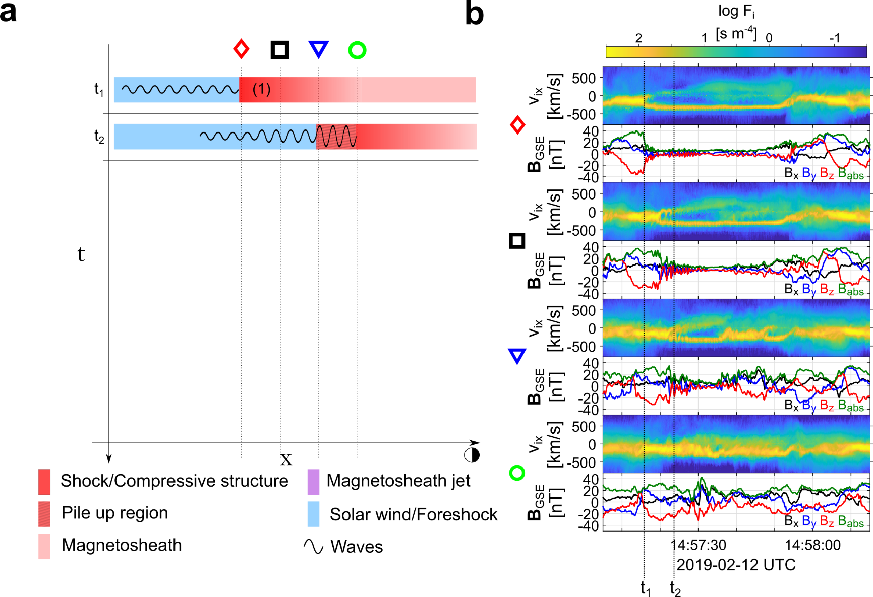
Formation mechanism

Slide 28
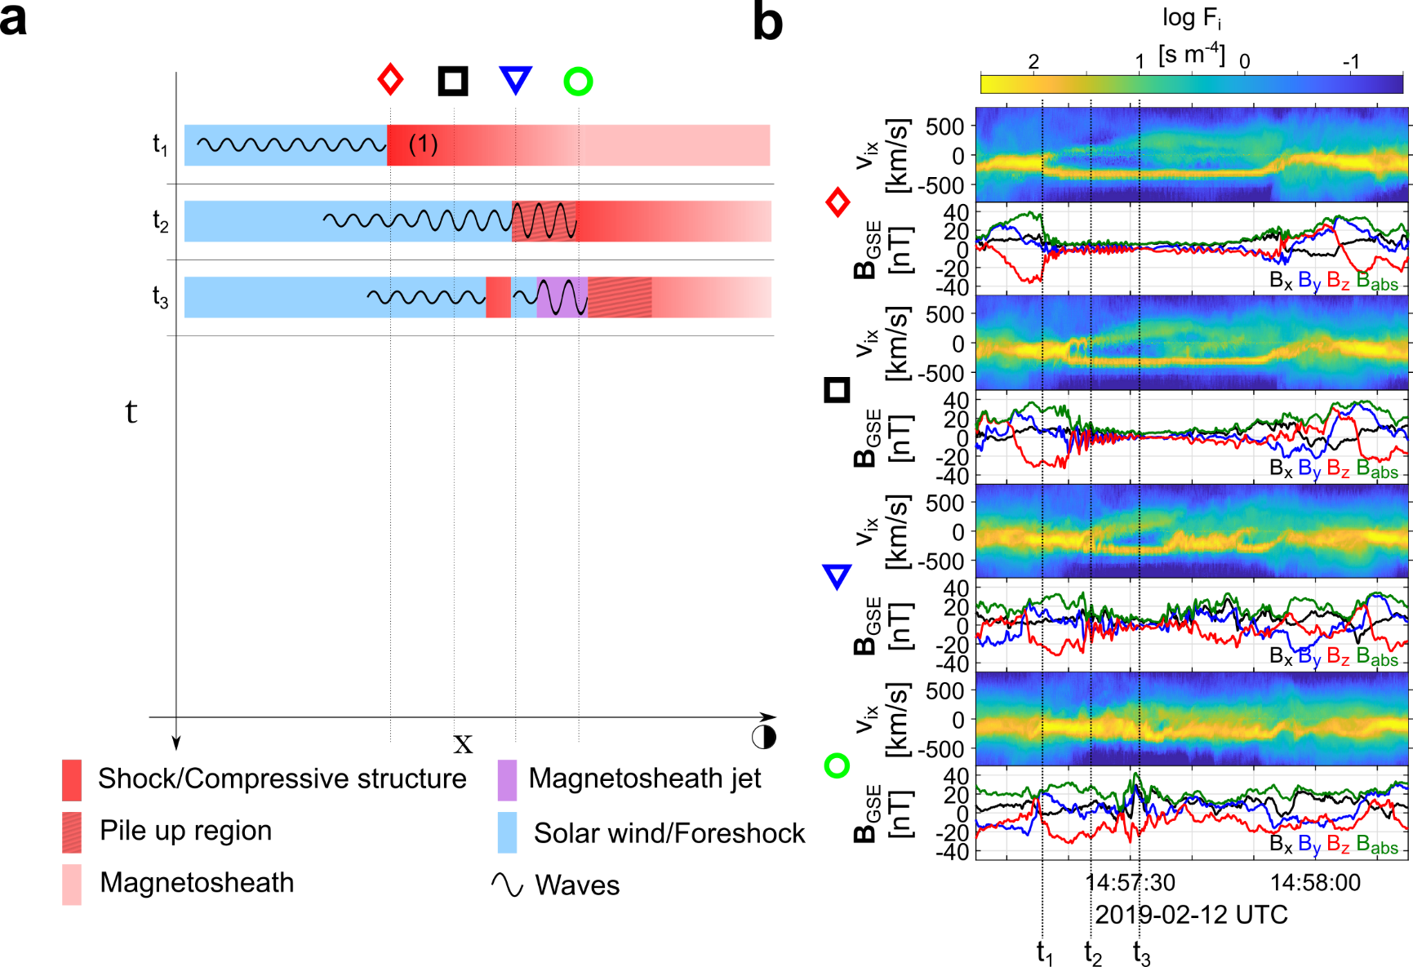
Formation mechanism

Slide 29
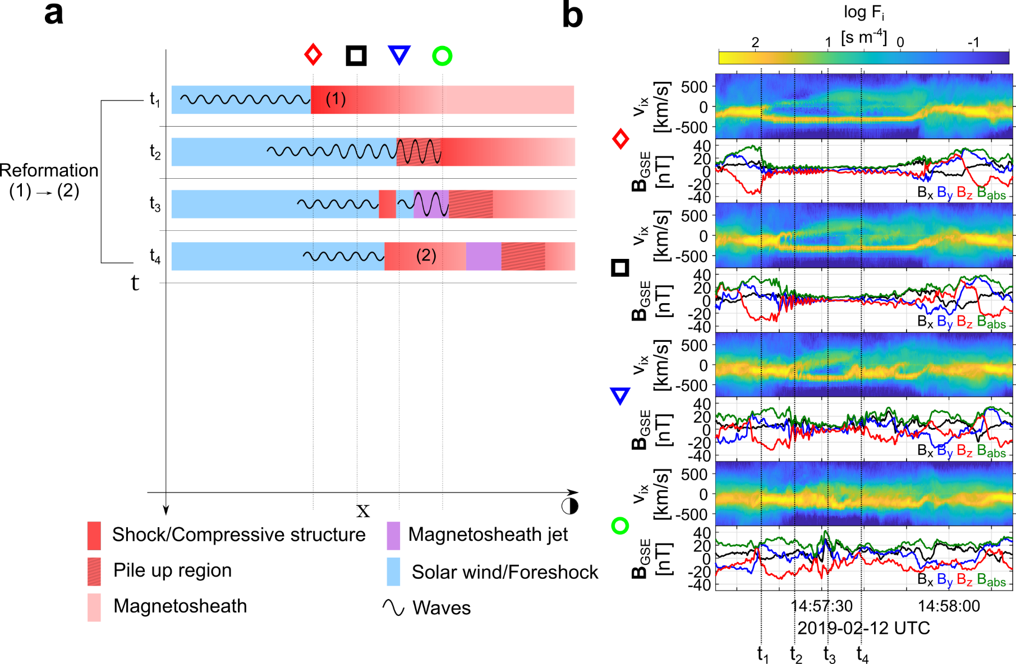
Formation mechanism

Slide 30
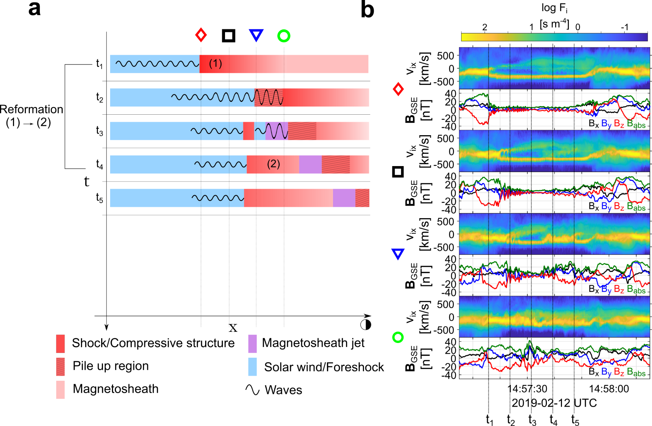
Formation mechanism

Slide 31
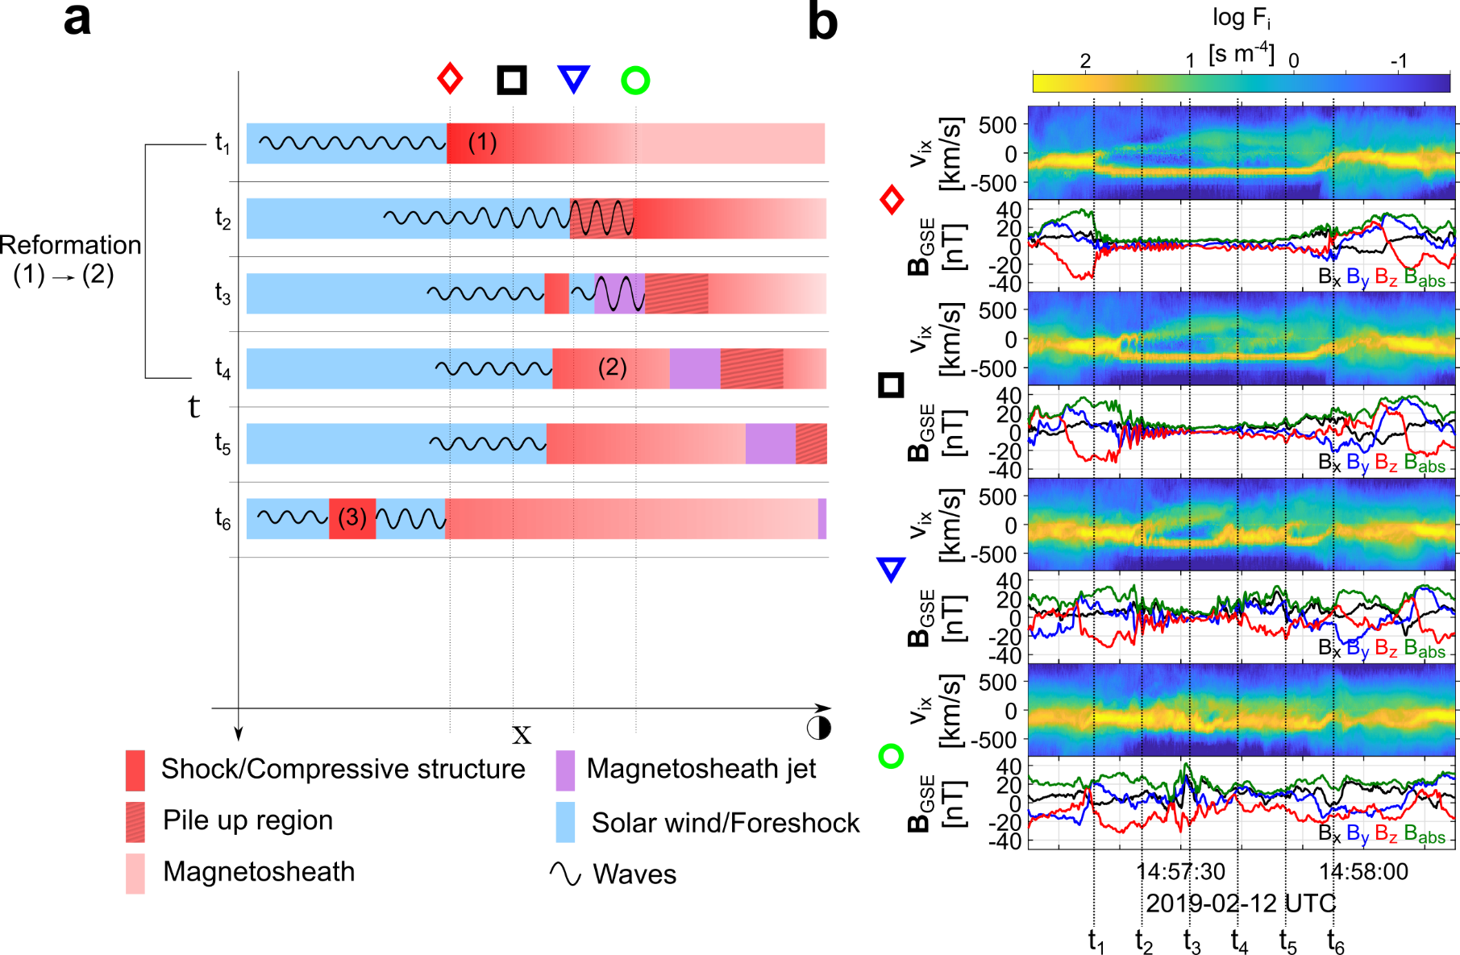
Formation mechanism

Slide 32
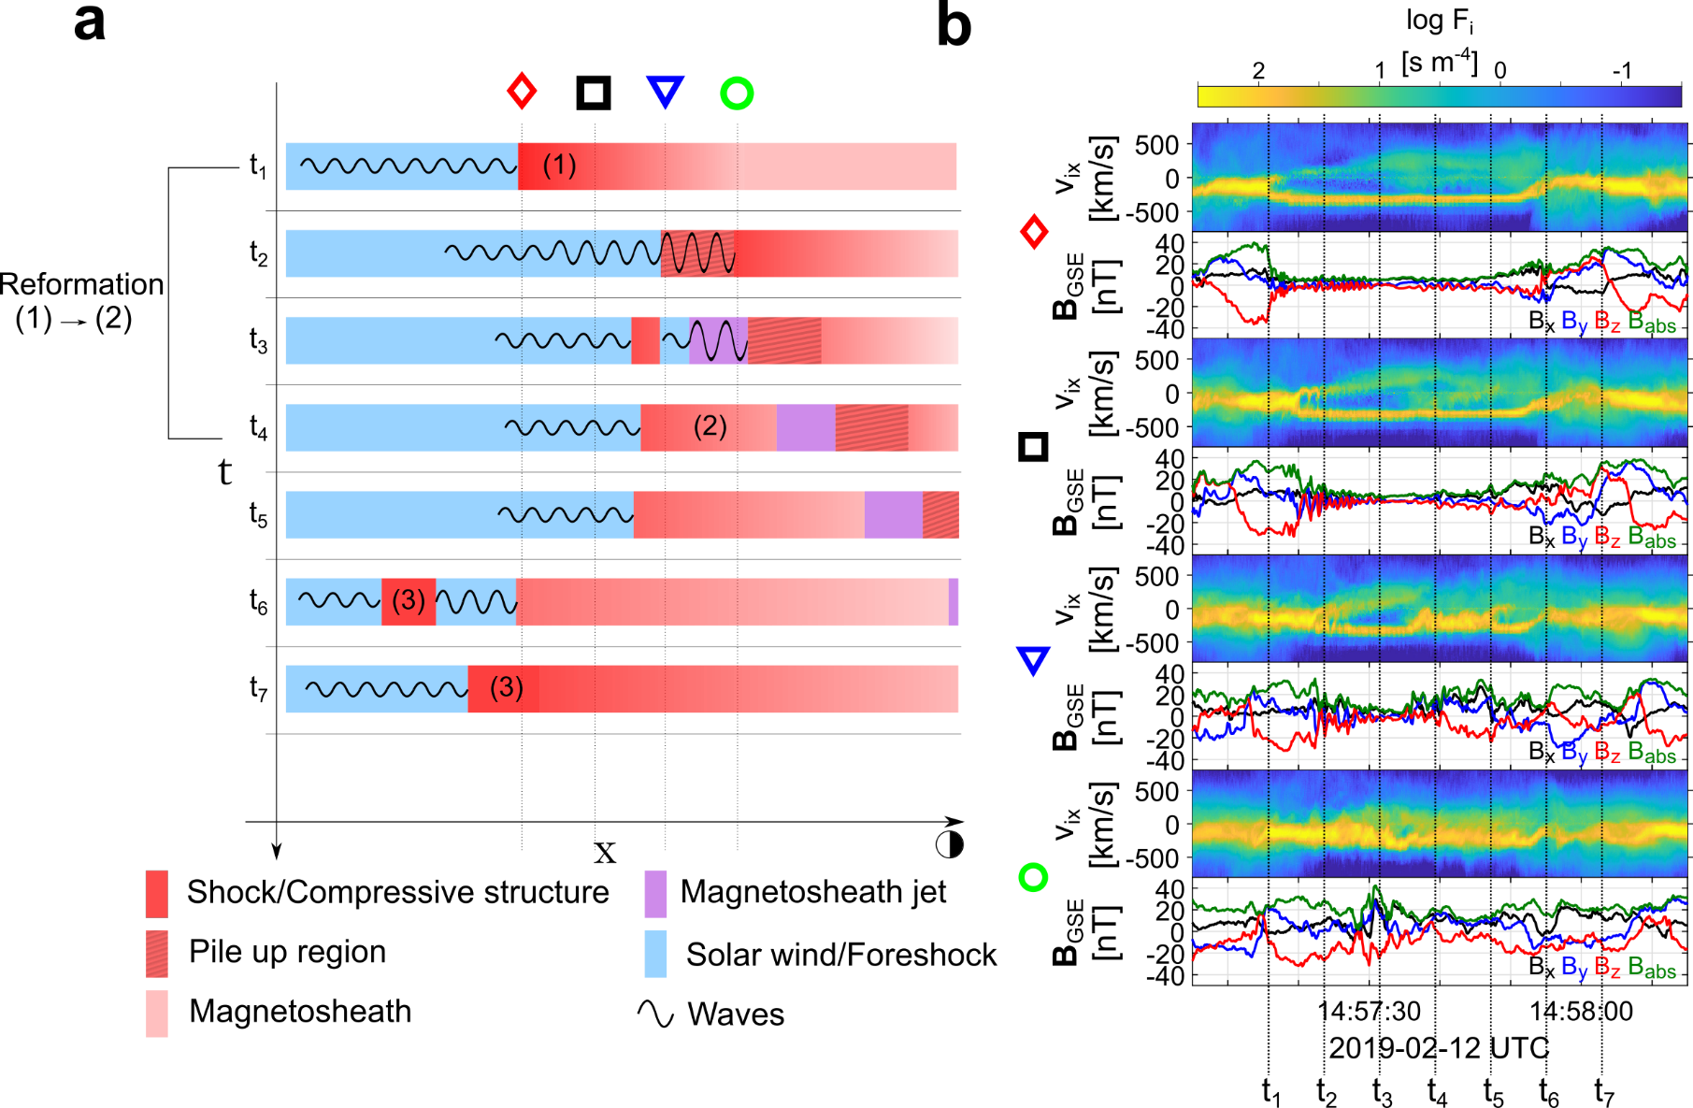
Formation mechanism

Slide 33
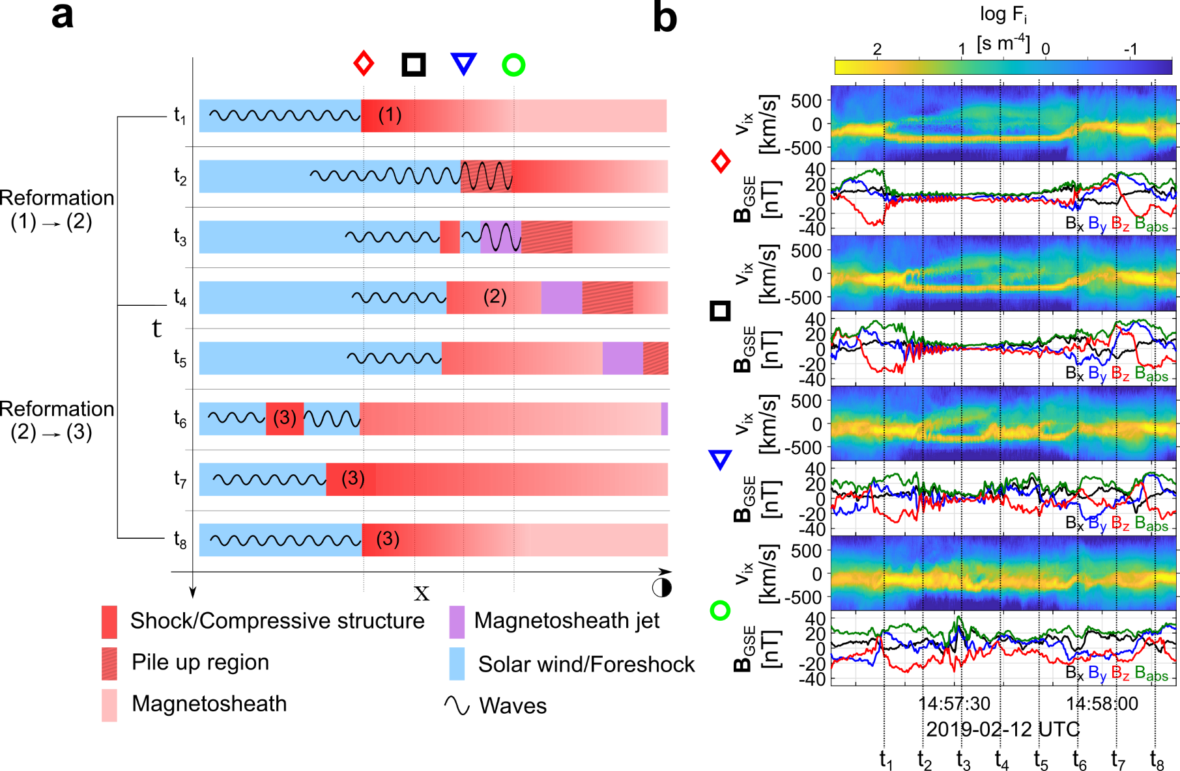
Formation mechanism

Slide 34


Summary & Conclusion
Main points
In-situ observations of shock fronts (SLAMS) becoming “embedded plasmoids” (density enhanced downstream regions).
in-situ observations of jets forming by the dynamical evolution of collisionless shock (reformation)
Implications
Possibly a general process of collisionless shocks that could be found in planetary, astrophysical and laboratory shocks.
Are ripples or SW phenomena “needed” to explain a subset of jets ? Or could a part of them be a foreshock phenomena extending downstream of the shock ?
Future work
Details on SLAMS/waves – Exact properties & evolution study of FCs numbered 1-3
Simulation comparison – Can we find cases like these in simulations ?
Statistics – We need more events, currently found ~3 of similar signatures.
Modeling – Can this process explain jets close to MP ? Or are just a subset of “small” jets ?
Electron Acceleration – Liu et al. (2020a, 2020b) : jets → bow wave → electron acceleration

Slide 35
Extras

Slide 36

Fast/Survey MMS data
Burst MMS data
Resolution (samples/s)
Resolution (samples/s)
FGM (magnetic field):
FPI (plasma moments | ions):
EDP (electric field):
0.0625
4.5
0.0313
0.0078
0.15
0.00012218
Pros
Always available
Decent resolution
Can be good for statistics due to availability
Pros
Very high resolution
Able to resolve structures close to boundary surfaces (e.g. mix of plasma close to magnetopause, bow shock, foreshock etc.)
Cons
Not available all the time, mostly available close to vital mission objectives (magnetopause, diffusion regions, shock transitions etc.)
Hard to do proper large scale statistics due to biases generated from specific availability and manual choice of intervals
Cons
Not suitable for small scale studies
Could be misleading close to boundary surfaces (Magnetopause, Bow shock etc.)
More information: Baker, et al. (2016) | Space Sci Rev 19

Slide 37
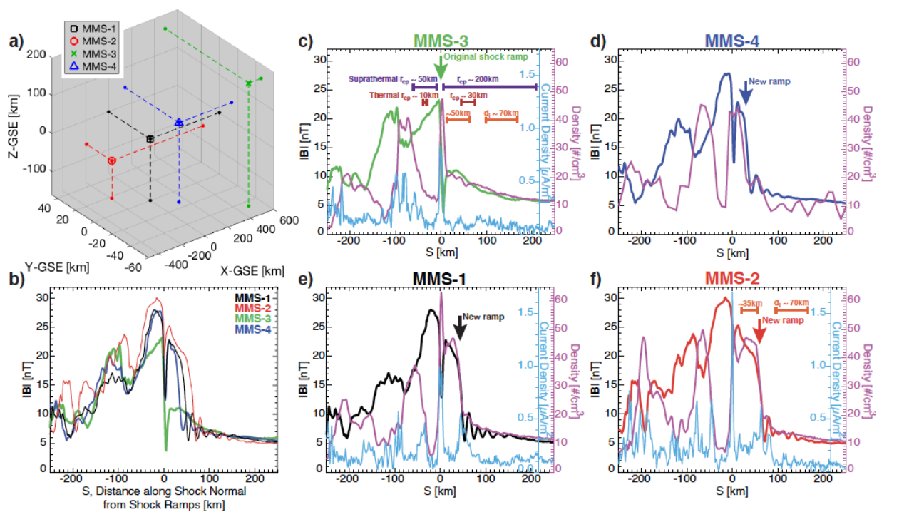
Turner et al. 2021 (local reformation/evolution)

Slide 38
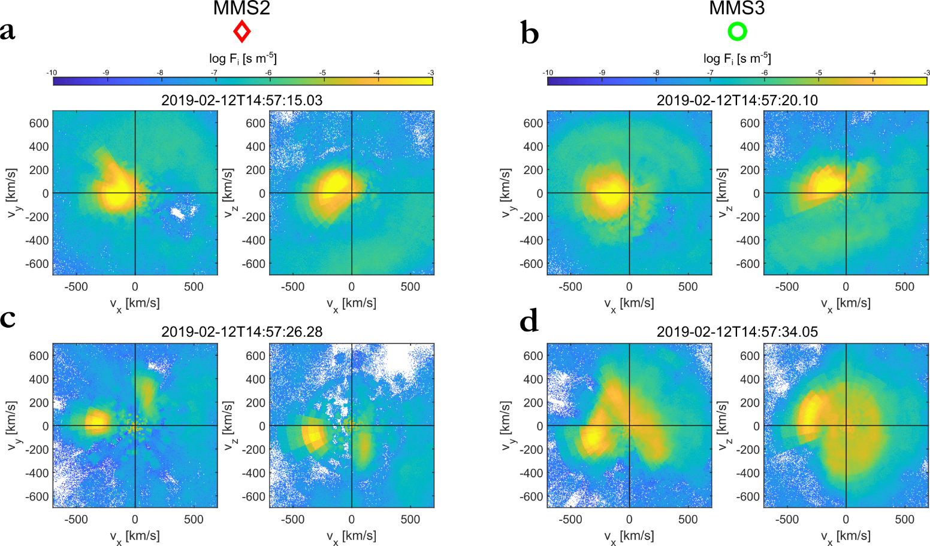
VDFs

Slide 39
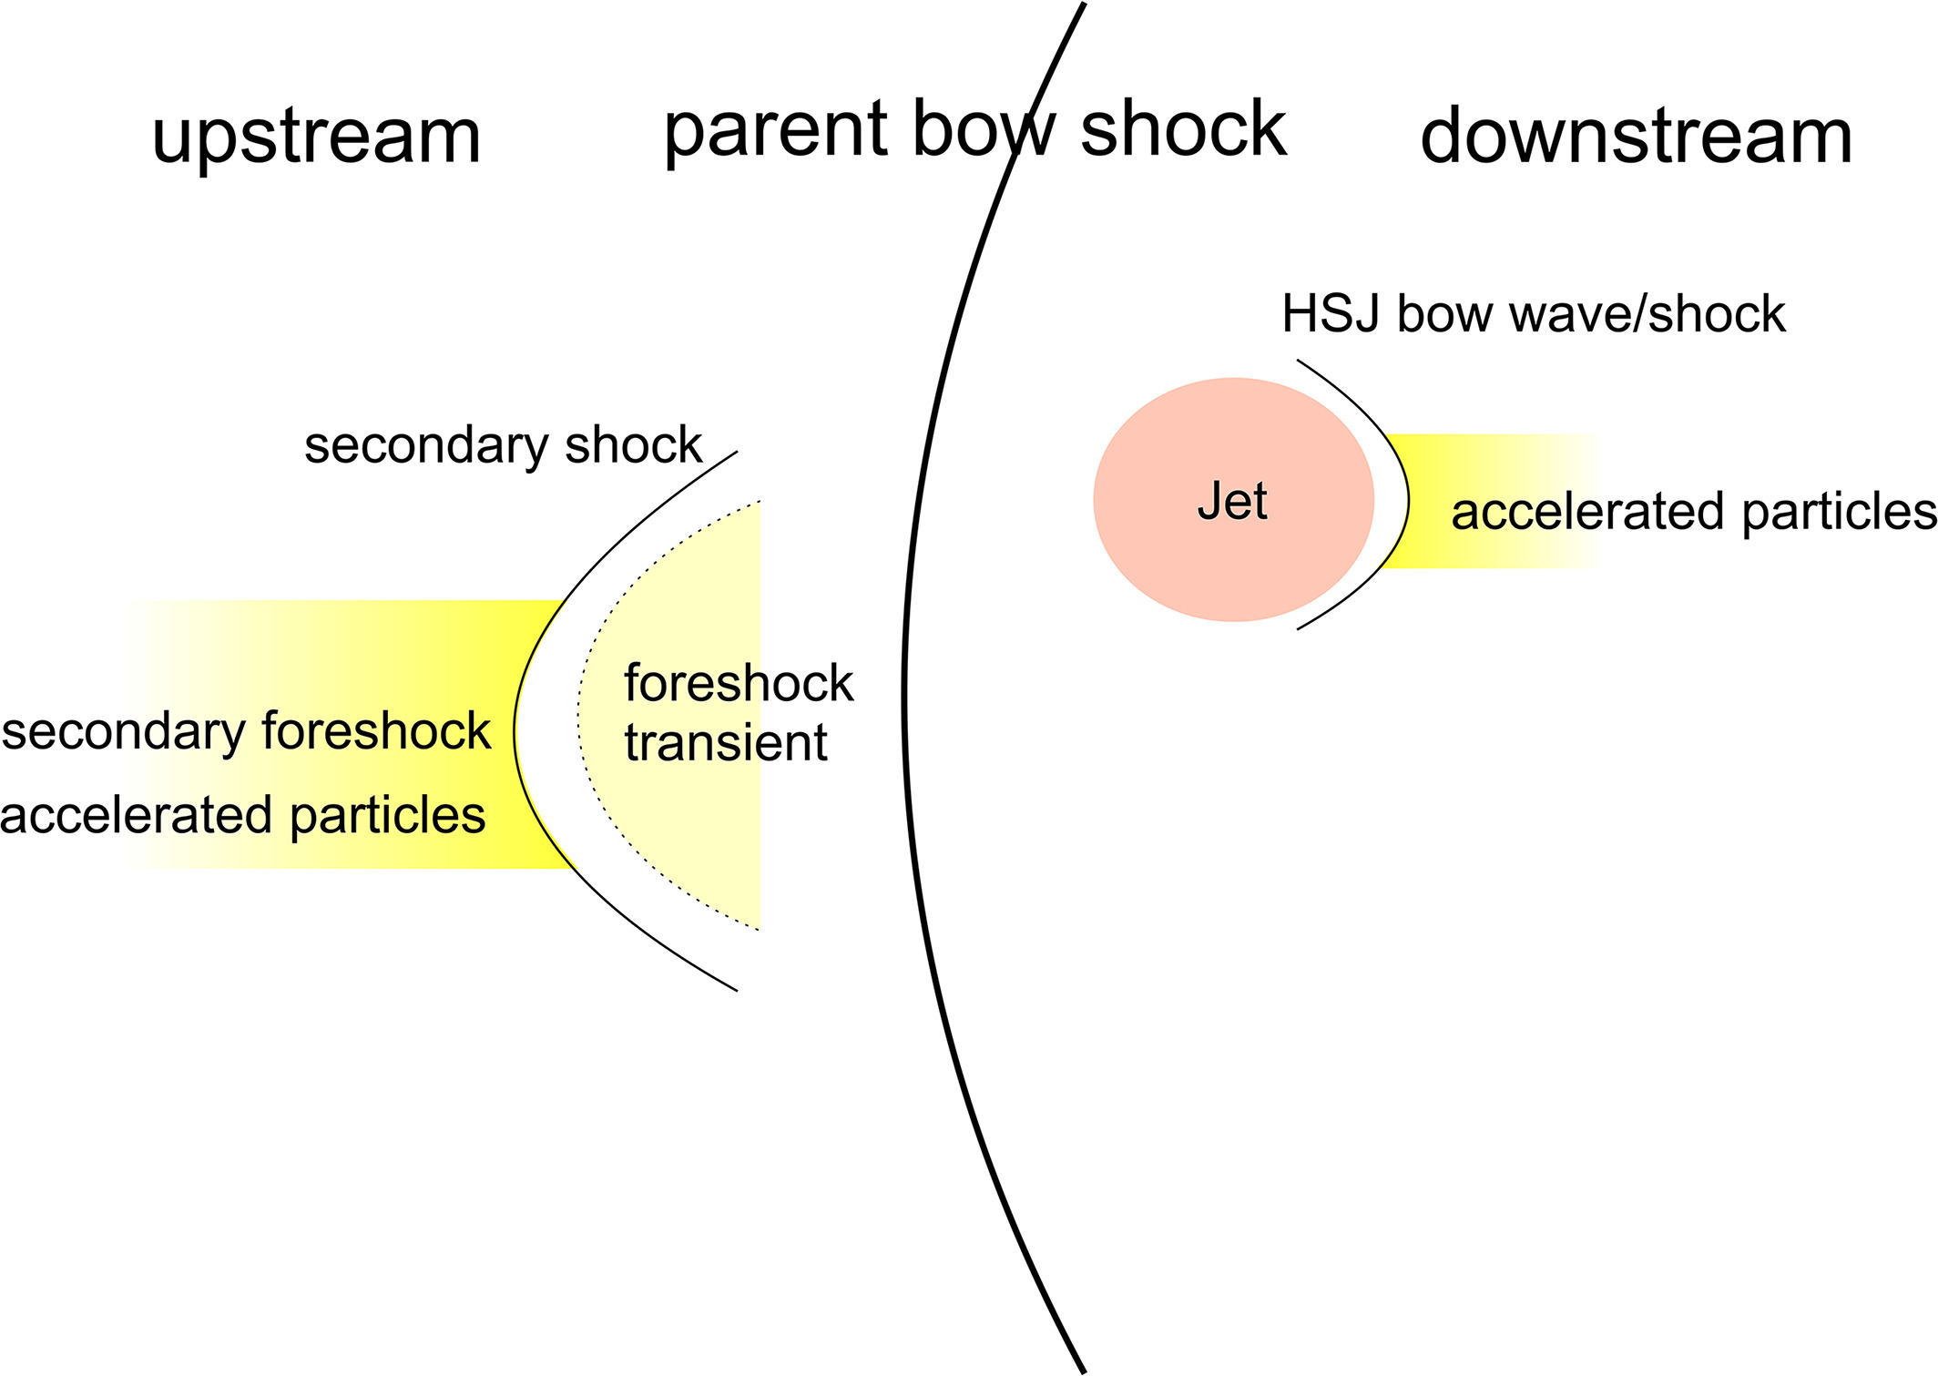
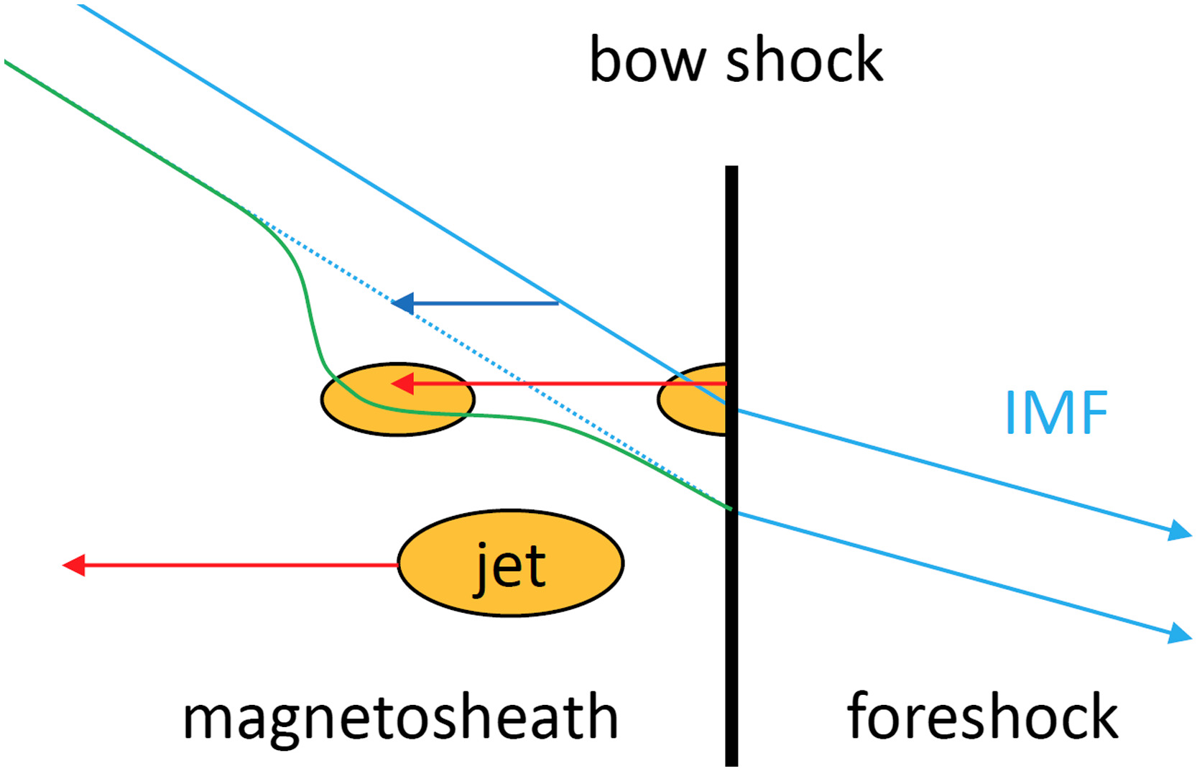
Jets interaction with ambient plasma
Liu et al. (2020)
Plaschke et al. (2018,2020)

